Slide 1
Brainstorming & Group Dynamics
Greg Smith

Slide 2
Introduction to myself
2nd year Grad Student
Working with Kelvin on AR/VR multi-user interactions
Current programmer of ASL a library for real-time interaction

Slide 3
Outline
Creating a Game is Hard
Cost
BioShock Pitch
Brainstorming Process
Generating Player Experience Goals
Producing ideas
Filtering ideas
Deliverables
Break
Working in a Group
Roles
Game Design Document
Notes:
Working in Group:
Roles = How to work in a group, what roles each person will have, and how those roles will change with time and stress.

Slide 4
Creating a Game is hard
Never as simple as we think
Platform
Story
Theme
Setting
Genre
Mechanics
Art
Music
Animation
Physics
AI Behavior
Economy
And More!

Slide 5
Cost of Games
The Witcher 3
$81 million to create and promote
3.5-year development cycle
BioShock
$15 million to create
5-year development cycle
Mortal Kombat 11
PTSD

Slide 6
BioShock deep dive

Slide 7
Player Experience Goals
Goals you set for the type of experience you want players to have
Descriptions of unique and interesting situations the player will be in
Not features
Examples:
Players must cooperate to win but they will feel like they can never trust each other
Players will feel relaxed instead of competitive
Players make up their own goals
Players get to perform tasks in whatever order they desire
Notes:
Very first thing you do
Gets you the feel of the game

Slide 8
Player Experience Goals II
Used to generate features
Ex: “Players will feel relaxed instead of competitive”
No time limit
No ranking system
Sandbox environment

Slide 9
Bioshock Player Experience Goals
Players will feel like they are the playable character
Players will feel like the world they exist in is plausible
Players will feel scared while playing

Slide 10
Player Experience Goals Template
Player feels…
Player wants to…
Player is encouraged to…

Slide 11
Individual Exercise I – 5 minutes
On your own, write down a list of player experience goals you would want for a game. You may produce multiple goals for one game or multiple games with different goals.

Slide 12
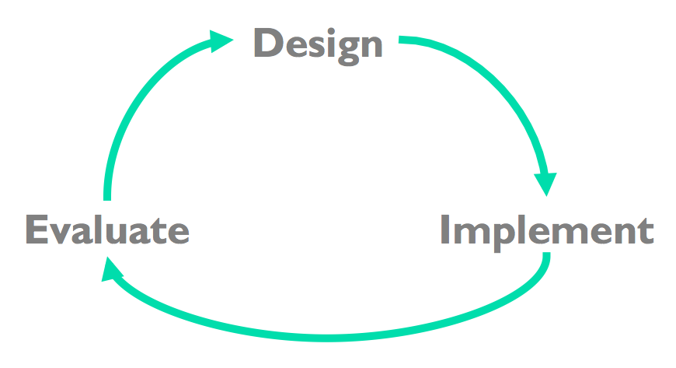
Player Experience Goals III
Prototype and Test features to ensure they meet player experience goals
Iterative Design Process
web.mit.edu

Slide 13
Player Experience Goals IV
There is no right way to produce an idea
Player Experience Goals is a great way to get started, but it can also be hard
Sometimes it is easier to think of features you want, and then to focus on what player experiences those features create
Ex. Want player’s health to drain over time
Player experience goal: Players will constantly feel under pressure to accomplish their tasks
Ultimately your game will have player experience goals

Slide 14
Producing Ideas
Chose a Genre and stick to it
FPS, RPG, Strategy, etc.
Pick a Niche
Sci-Fi, Fantasy, Western, Adventure, Thriller, Action, etc.
Research what’s popular now
Trending Games, ask people what they would/wouldn’t play, etc.
Look to what media you like
Books, movies, video games, etc.
Copy and improve another idea
League of Legends vs Dota 2 vs Awesomenauts

Slide 15
Producing Ideas II
Idea Spam
No idea is a bad idea
Quantity > Quality
Conflicting ideas are ok
Ex: “Players will feel relaxed instead of competitive”
Sandbox world
Linear game play

Slide 16
Bioshock Ideas
Players will feel like they are the playable character
Freedom to hack into and control security and environmental systems
Create and customize personal weapons
Discover and use genetic enhancements to customize the character
Players will feel like the world they exist in is plausible
Realistic ragdoll physics
Believable story
Stunning visuals and realistic underwater city planning
Players will feel scared while playing
NPCs look scary – Zealot cultists, Genetically engineered mammals, Cyborg killers, Robots, etc.
Jump scares via NPC sneak attacks
Minor key, fast paced music

Slide 17
Individual Exercise II – 5 minutes
By yourself, write down a list of features that match your player experience goals. Each player goal you have should have at least one feature that would create that experience.

Slide 18
Producing Ideas III
Let your subconscious do some thinking
Take breaks
Stretch
Snack
This does not mean procrastinate
Notes:
Game Design Workshop page 148

Slide 19
Filtering Ideas
Is it technically feasible?
Do you have the skills, know-how, and programs to make want you want?
Ex: Interactive NPCs
There’s a reason why NPCs in RPGs repeat or cycle through what they say all the time
Do you have the art skills?
Can what you want to do be drawn and animated?
Ex. Player walking, world environments, enemies, cutscenes, etc.
Notes:
Goal: Turn ideas into good ideas
WoW public Auction House has a 15% tax

Slide 20
Filtering Ideas II
What is the cost?
Everything you should use should be free.
Ex. Asset packs, AI behavior, etc.
Does it appeal to only you or a large audience as well?
Ex: Want a gun in a serious FPS story game that shoots dinosaurs, etc.
Do you have the time?
Can you accomplish what you want to accomplish in a 2-month time frame?
However long you think something will take you – double it

Slide 21
Filtering Ideas III
Quality > Quantity
Use a ranking system
No idea is ever “gone”

Slide 22
Individual Exercise III – 5 minutes
By yourself, filter out your previous ideas and say why.
Technically Feasible?
Art skills?
Cost?
You vs Everybody?
Time?

Slide 23
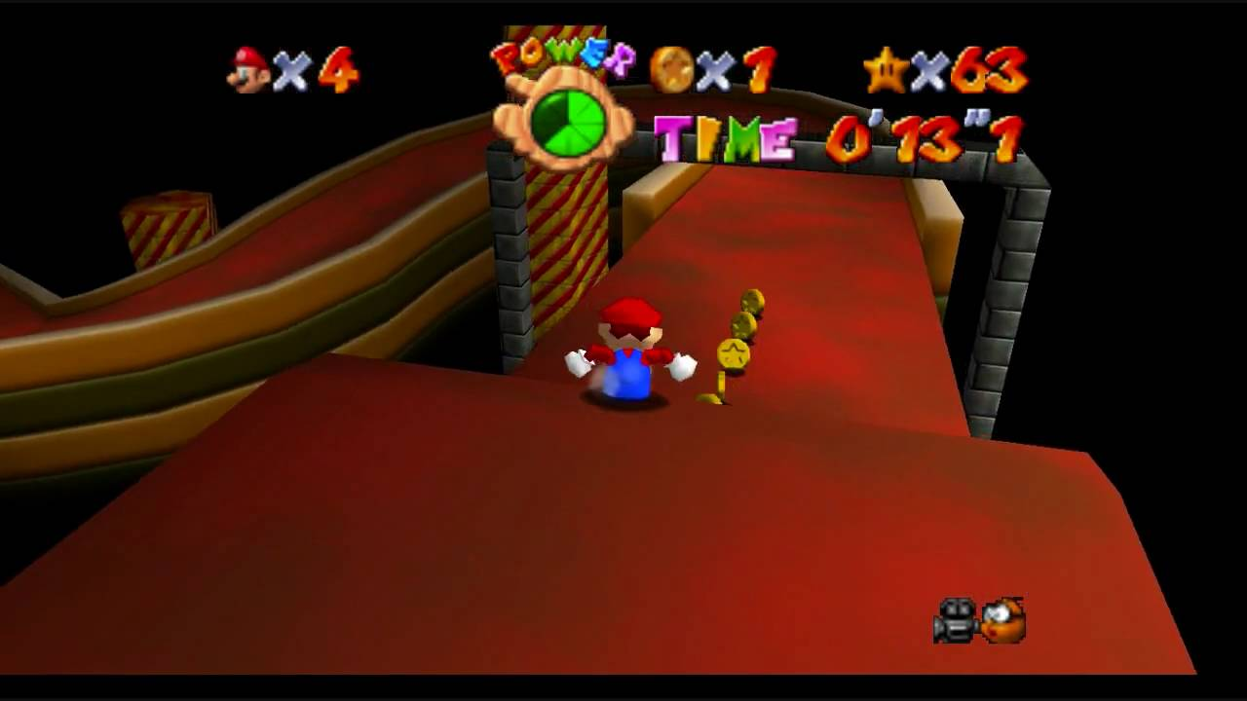
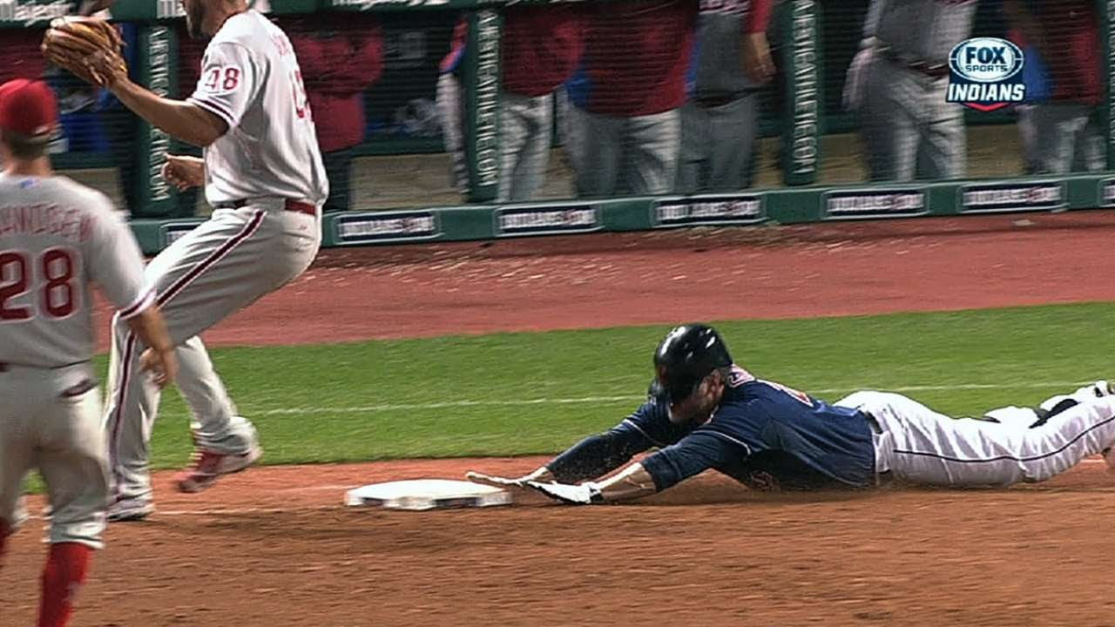
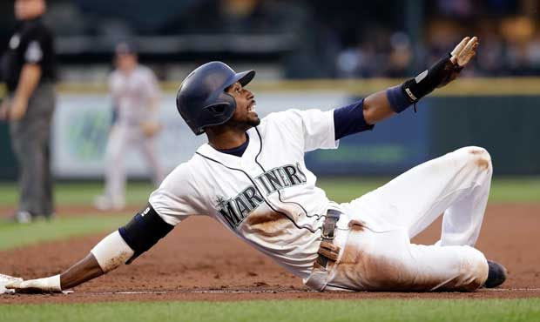
Deliverables
Storyboard – 1:1 with game mechanics
A picture speaks a 1000 words
Use screenshots from existing games or media
Communicate your ideas, not your art skills
Show how a feature is executed
Feature: Players can slide
https://www.youtube.com/watch?v=msSuNTddu4k
http://www.youtube.com/watch?v=UTikOHMCNLg
http://sports.mynorthwest.com/501124/drayer-mariners-slide-has-lasted-a-month-and-changes-could-be-made-to-address-it/

Slide 24
Deliverables II
Game Design Document (GDD)
A document that is used as the backbone of your game
Last brainstorming session should show an approximate outline of a GDD
Includes storyboard
Template:

Slide 25
Deliverables III
Overview of your game
Theme
First Person Action Horror
Genre
Sci-Fi
Setting
Underwater City - 1960
Targeted Platforms – PC, console(s), mobile, VR/AR
PC and Xbox
Related games and how
Thief – stealth mechanics and world interaction
Player Experience Goals (Elevator Pitch)
Players will feel immersed and scared
Project Description
An FPS horror set in a steam punk/diesel pink like city where players will control the fate of Carlos as he tries to find the daughter of a captain of industry all the while trying to understand and fathom the depth of the cult he has found himself in

Slide 26
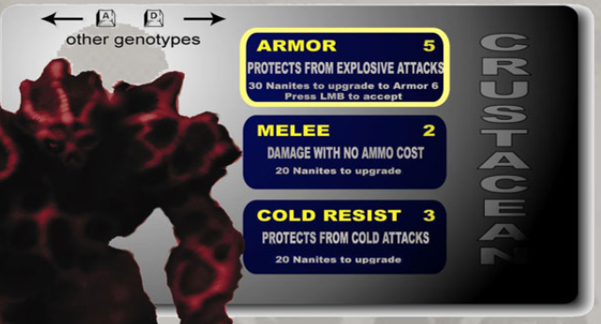
Deliverables IV
Features
Describe
Genetic Enhancements – Modify your genome to change gameplay
Storyboard
Story and Gameplay
Describe
You have been tasked with finding and returning the daughter of an important man – what could go wrong?
Storyboard
Assets needed
Rough approximation
Characters, NPCs, cities, weapons, etc.
Schedule
When and who does what
Main Menu – Week 1
Character movement – Week 2
Collision handling – Week 3

Slide 27
Individual Exercise IV – 10 minutes
By yourself, write down the GDD outline for your game. Make sure to include the following:
Overview
Genre, theme, setting, platform, 1 related game, player experience goals, and 1-2 sentence project description
Features with clear descriptions
Story outline (if present)
Gameplay outline
Assets needed
Approximately when each feature will be complete

Slide 28
Working in a Group
Brainstorming individually vs as a group is different
More potential for good ideas and ideas you don’t like
Be prepared before brainstorming together

Slide 29
Roles
Facilitator
Individual who has the final say
Turns in assignments for the group
Coordinates meeting times
Facilitates group dynamics
Resolves disagreements and/or gets the help necessary to resolve disagreements
Delegates tasks
Understand that people work at different times and rates and adjusts work quantity accordingly

Slide 30
Roles II
Roles everybody will play
Designer
Programmer
Artist
Tester
Quality Assurance
Must be flexible and willing to pick up slack when and where it occurs

Slide 31
Roles – Brainstorming
Facilitator: Set a goal for that brainstorming session
Want 10 Player Goal Experiences conflicting or not
Want 5 features per Player Goal Experience
Want 1 GDD outline
Encourage ideas – good or bad (Idea Spam Phase)
Make all ideas visible to all group members

Slide 32
Group Exercise I – 5 minutes
Create a small group, 2 – 3 people, and write down on a new piece of paper Player Experience Goals and ideas to match these goals. You may use your individual player experience goals and ideas. Remember to match ideas to goals and that an idea (feature, theme, genre, etc.) can be matched with more than 1 goal.

Slide 33
Roles – Brainstorming II
Filter ideas as a group via constructive criticism (Filter Idea Phase)
Access your group’s experience, ability, and time commitments to help further refine ideas
Discover conflicting ideas/features. If no quick consensus on which to use, then use the ranking system
Ranking System
Each member casts their vote on each conflicting idea/feature, the idea with the highest score wins and the other idea is dropped
Facilitator breaks ties
Learn to live with and make the best of disappointment

Slide 34
Group Exercise II – 5 minutes
As a group, assess your ability to perform the ideas you have generated. To do this successfully, you must share your experience with video game creation, programming, art, and how much time you can commit. After sharing and accessing these qualifications, refine your idea list and say why each one made the cut (or why the others didn’t).

Slide 35
Game Design Document
Deliverables
Using your filtered ideas and Player Experience Goals create an outline of your group’s GDD.
GDD is the same as before, but storyboarding is even more important as each group member will have a slightly different idea of what a feature/idea entails
GDD’s schedule must now include who does what as well

Slide 36
Game Design Document II
Your final GDD should match your final game 1:1
Remember the Iterative Design Process
Your game will change as it develops
Your GDD should reflect these changes
One easy way to resolve disputes is to check the GDD – if its not there, it shouldn’t be in the game
To complete your GDD, flush out your outline, providing as clear as possible descriptions and images to describe everything in your game
web.mit.edu

Slide 37
Final Notes
Write everything down
How you break up a brainstorming session is up to you
Avoid Scope Creep – every feature you add is one less feature you can perfect
Check in with group member’s frequently and often
No news is bad news!
Discord is a great, free, software that will allow you to group text and voice chat, as well as pass along small documents and images to each other
Assign personal due dates before the actual due date
Unforeseen bugs always occur

Slide 38
Final Notes II
Use a source control
Unity allows up to 3 members to collaborate on a single group
Easiest method
Public GitHub repository allows for unlimited group members
Harder to setup, organize, and use than Unity, but still a great method
Easier to backtrack to a working version if something goes wrong
Save multiple copies
Source control helps with this, but multiple saves never hurt
Bugs (in games) are fatal!!
Less game with no bug
More game with some bug

Slide 39
References
Game Design Workshop by Tracy Fullerton – Player Experience Goals & brainstorming process
https://www.gamedesigning.org/gaming/game-ideas/ - How to generate Game Ideas
https://www.wowhead.com/forums&topic=65217/auction-house-cut - How WoW helps balances in-game economy
https://remembereverything.org/brainstorming-idea-evaluation/ - How to evaluate ideas
Creating Games by Morgan McGuire & Odest Chadwicke Jenkins – Brainstorming for games
Moradian, Ali, Maaz Nasir, Kelly Lyons, Rock Leung, and Susan Elliott Sim. “Gamification of Collaborative Idea Generation and Convergence.” In Proceedings of the Extended Abstracts of the 32nd Annual ACM Conference on Human Factors in Computing Systems - CHI EA ’14, 1459–64. Toronto, Ontario, Canada: ACM Press, 2014. https://doi.org/10.1145/2559206.2581253. – Brainstorming by making the process a game
Wilson, Chauncey E. “Brainstorming Pitfalls and Best Practices.” Interactions 13, no. 5 (September 1, 2006): 50. https://doi.org/10.1145/1151314.1151342. – Brainstorming methods – Good read
https://kotaku.com/how-much-does-it-cost-to-make-a-big-video-game-1501413649 - The cost to make video games
https://en.wikipedia.org/wiki/BioShock - General information about BioShock
https://kotaku.com/the-past-present-and-future-of-the-witcher-3-1736499084 - General information about the Witcher 3
https://www.rt.com/news/458864-mortal-kombat-game-developer-ptsd/ - Information about PTSD for game developers
https://docs.google.com/document/d/1HjlGwE57xlmp9Hf4u-mHt5qeem6kpbWJQzUWd0feDhg/edit?usp=sharing – Link to a list of references that can be useful for brainstorming and working in a group. Some of the resources are repeats and some are ones that were not used in this presentation, but still helpful information.

Slide 40
Questions?

